Slide 1
Machine Learning 06- Support Vector Machine
Dr. Malak Abdullah
Computer Science Department
Jordan University of Science and Technology

Slide 2
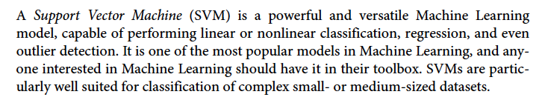
SVM

Slide 3
Classification
Linearly separable classes
Goal: find a linear decision boundary (hyperplane) that separates the classes

Slide 4
Linearly separable classes
One possible solution

Slide 5
Linearly separable classes
Another possible solution

Slide 6
Linearly separable classes
Other possible solutions

Slide 7
Which one is better?
Which one is better? B1 or B2? How do you define better?

Slide 8
Which one is better?
Fitting the widest possible street between classes ☺
Hyperplane that maximizes the margin will have better generalization => B1 is better than B2

Slide 9
Noisy data
Hyperplane that maximizes the margin will have better generalization => B1 is better than B2

Slide 10
Noisy data
This is the Maximum Margin Classifier. It maximizes the margin of the hyperplane. This is the best hyperplane because it reduces the generalization error the most. If we add new data, the Maximum Margin Classifier is the best hyperplane to correctly classify the new data.
The Maximum Margin Classifier is our first SVM. But this SVM requires the two classes to be completely linearly separated. This isn’t always the case so in 1993 Vapnik developed another one of his machines.
Hyperplane that maximizes the margin will have better generalization => B1 is better than B2

Slide 11
Support Vector Machines
Here we approach the two-class classification problem in a direct way:
We try and find a plane that separates the classes in feature space.
If we cannot, we get creative in two ways:
We soften what we mean by “separates”, and
We enrich and enlarge the feature space so that separation is possible.

Slide 12
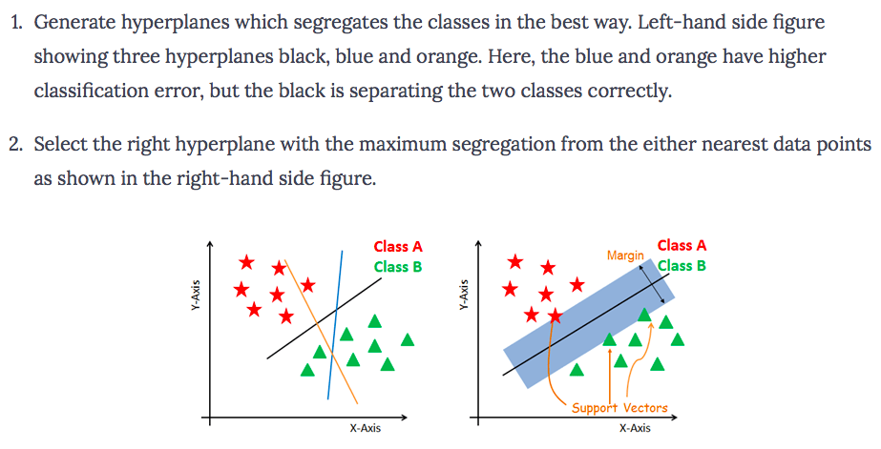
How does SVM work?
The objective is to select a hyperplane with the maximum possible margin between support vectors in the given dataset. Follow these steps:

Slide 13
Terminologies
Support vectors are the data points, which are closest to the hyperplane. These points will define the separating line better by calculating margins.
A hyperplane is a decision plane which separates between a set of objects having different class memberships.
A margin is a gap between the two lines on the closest class points. If the margin is larger in between the classes, then it is considered a good margin, a smaller margin is a bad margin.
large margin classifiers, maximum margin classifiers
Support Vector Classifier, soft marginal classifier
Support Vector Machines

Slide 14
What is a Hyperplane?
A hyperplane in p dimensions is a flat affine subspace of dimension p − 1.
In general, the equation for a hyperplane has the form
β₀ + β₁X₁ + β₂X₂ + . . . + β_{p}X_{p} = 0
In p = 2 dimensions, a hyperplane is a line.
If β₀ = 0, the hyperplane goes through the origin, otherwise not.
The vector β = (β₁, β₂, · · · , β_{p}) is called the normal vector
— it points in a direction orthogonal to the surface of a hyperplane.

Slide 15
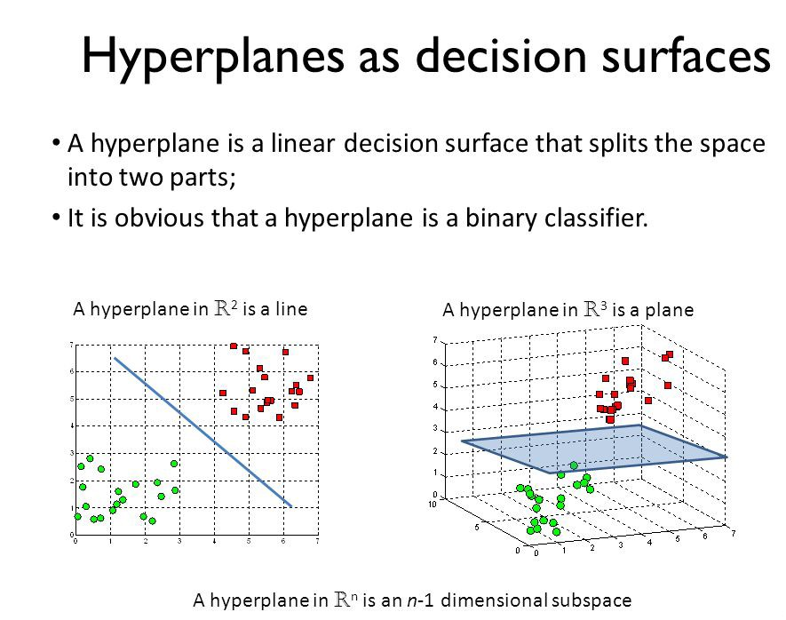
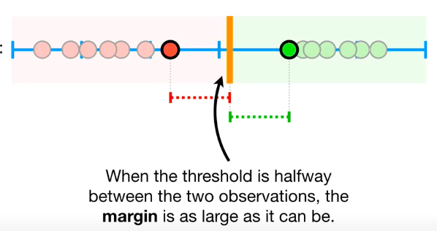

Slide 16
If we have only one feature
If X >= 60, then pass
If X < 60, then fail
------------------------------------ *******************
0 10 20 30 40 50 60 70 80 90 100
if Grade >=60 red
If Grades < 60 blue
1
-1
20 40 60 80 100

Slide 17
Look at this figure
X1 X2 Y
--------------------------
0. 0 blue
-1. 0 red
0 1 blue
-1 -1 red
-1 1 blue
0.5 -1 red
…etc
Hyperplane 1+2x₁+3x₂=0
if x1=0 and x2= 0 the hyperplane > 0 blue
if x1=0 and x2= 1 the hyperplane < 0 red

Slide 18
Hyperplane in 2 Dimensions
10
8
β=(β₁,β₂)
●
●
6
β₁X₁+β₂X₂−6=1.6
β₁X₁+β₂X₂−6=0
●
X₂
4
●
β₁X₁+β₂X₂−6=−4
2
●
●
0
−2
β₁ = 0.8
β₂ = 0.6
−2
0
2
4
6
8
10
X₁

Slide 19
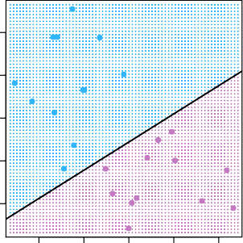
Separating Hyperplanes
3
X2
−1 0 1 2 3
2
X2
1
0
−1
−1 | 0 | 1 | 2 | 3 | −1 | 0 | 1 | 2 | 3
 |  | X1 |  |  |  |  | X1
If f (X) = β₀ + β₁X₁ + · · · + β_{p}X_{p}, then f (X) > 0 for points on one side of the hyperplane, and f (X) < 0 for points on the other.
If we code the colored points as Y_{i} = +1 for blue, say, and Y_{i} = −1 for mauve, then if Y_{i} · f (X_{i}) > 0 for all i, f (X) = 0 defines a separating hyperplane.

Slide 20
Salary for poor or rich people
80 200 500 800 1000 20,000
Which one is better?
If salary <=500 then he is poor, else, rich
If salary >=800, then he is rich , else poor
If salary >=650, then rich, else poor

Slide 21
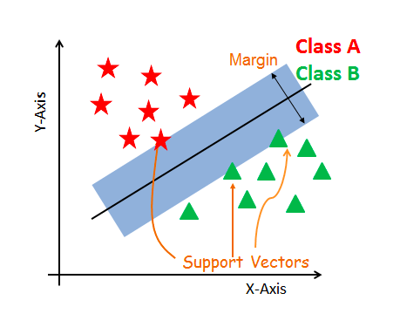
The core idea of SVM
SVM constructs a hyperplane in multidimensional space to separate different classes.
SVM generates optimal hyperplane in an iterative manner, which is used to minimize an error.
The core idea of SVM is to find a maximum marginal hyperplane(MMH) that best divides the dataset into classes.

Slide 22
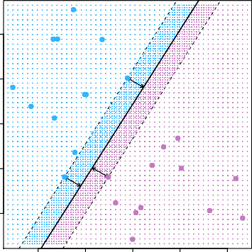
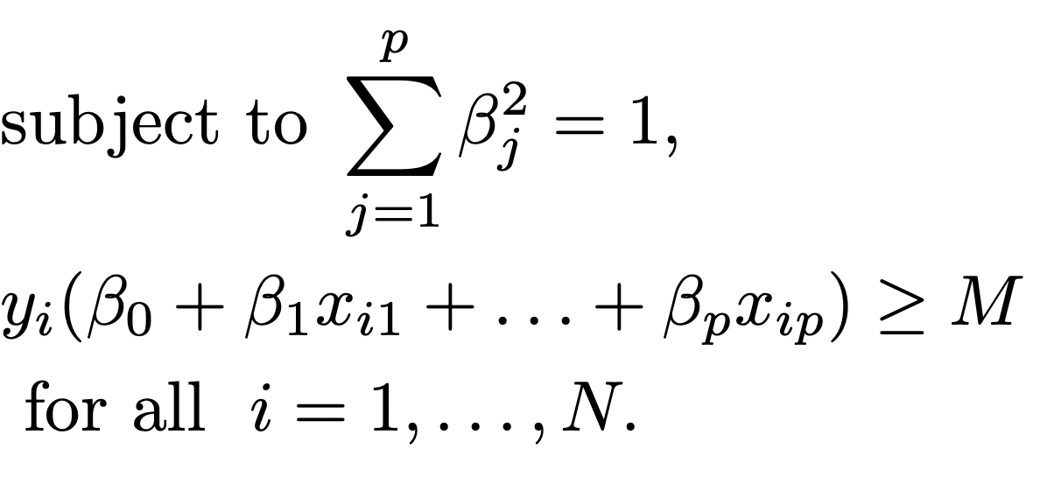
Maximal Margin Classifier
Among all separating hyperplanes, find the one that makes the biggest gap or margin between the two classes.
Constrained optimization problem maximize M
β0,β1,...,βp
^{X}2
−1 0 1 2 3
−1
0
1
2
3
^{X}1
5 / 21

Slide 23
Margin
The distance between the line and the closest data points is referred to as the margin.
The best or optimal line that can separate the two classes is the line that as the largest margin.

Slide 24
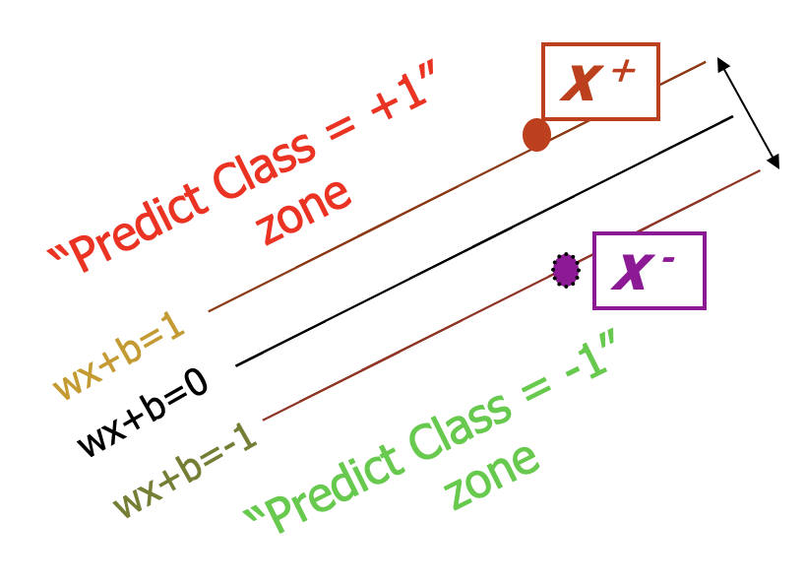
Margin
M=Margin Width
What we know:
w . x⁺ + b = +1
w . x⁻ + b = -1
w . (x⁺-x⁻⁾ = 2

Slide 25
Maximum Margin
We want to maximize:
But subject to the following constraints:

Slide 26
Which one is better?
Hard Margin:
we require all data points be classified correctly
No training error
Now which one is better? B1 or B2? How do you define better?

Slide 27
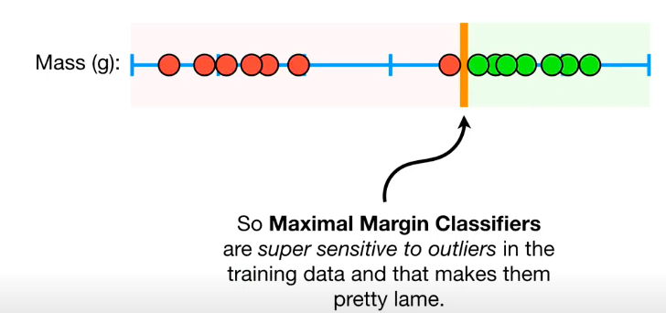
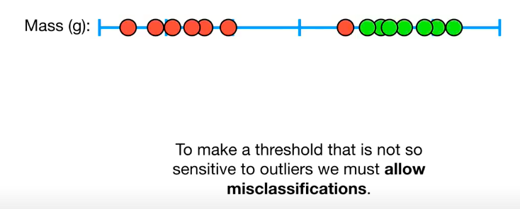
Underfitting vs Overfitting
In this case, the Maximum Margin Classifier would not work. Vapnik developed a soft margin that would allow for some misclassification of data.
https://www.youtube.com/watch?v=efR1C6CvhmE

Slide 28
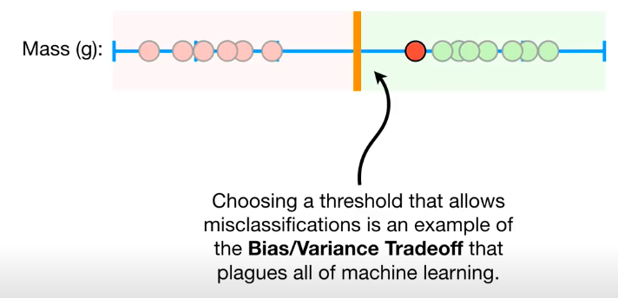

Slide 29
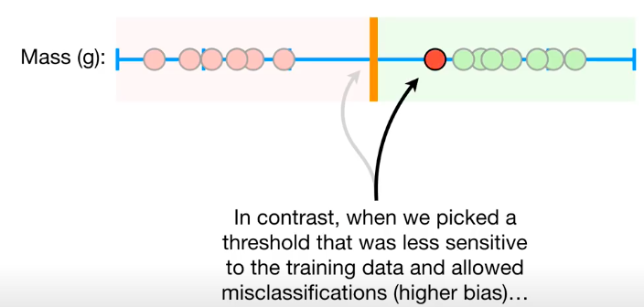
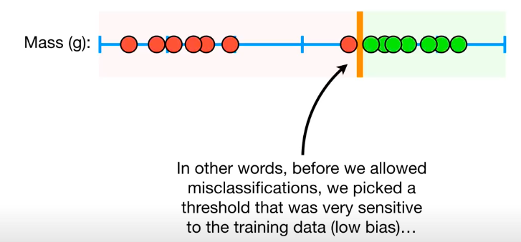
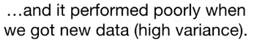
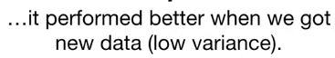
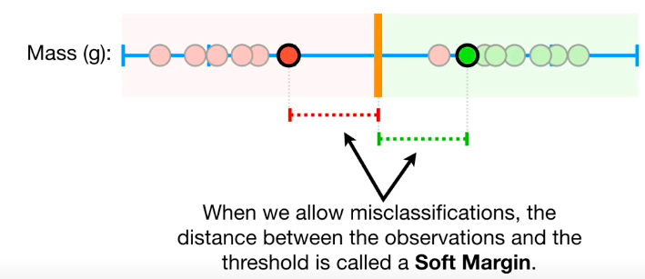

Slide 30
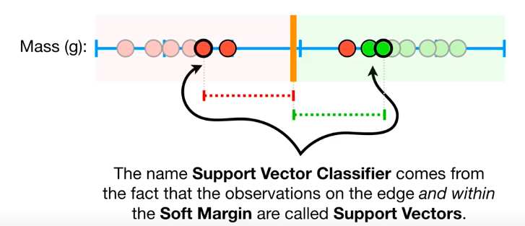
This is known as a Soft Margin Classifier or a Support Vector Classifier. It also attempts to maximize the margin separating the two classes.

Slide 31
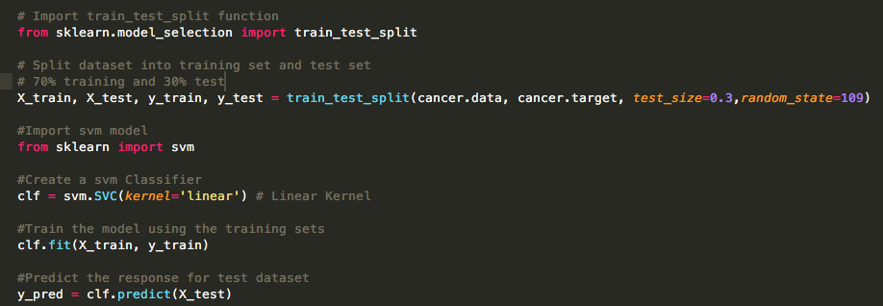
Split, fit, and predict
From sklearn. Svm import linearSVC Is much faster ☺

Slide 32
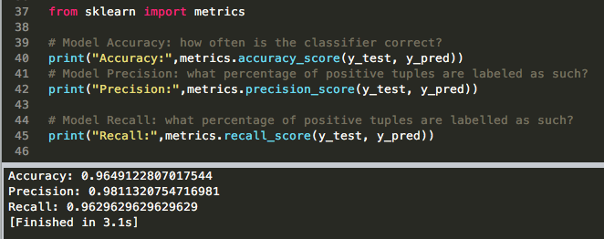
Evaluating

Slide 33
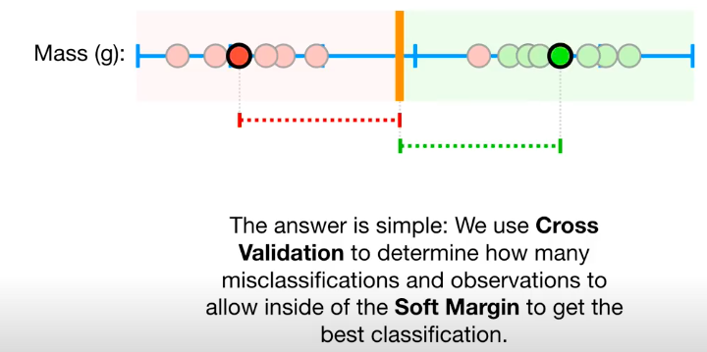
How Do we know which soft margin to choose?

Slide 34
Non-separable Data
^{X}2
−1.0 −0.5 0.0 0.5 1.0 1.5 2.0
The data on the left are not separable by a linear boundary.
This is often the case, unless N < p.
0
1
2
3
^{X}1

Slide 35
Noisy Data
3
3
2
2
X₂
1
X₂
1
0
0
−1
−1
−1 | 0 | 1 | 2 | 3 | −1 | 0 | 1 | 2 | 3
 |  | X₁ |  |  |  |  | X₁
Sometimes the data are separable, but noisy. This can lead to a poor solution for the maximal-margin classifier.
The support vector classifier maximizes a soft margin.

Slide 36
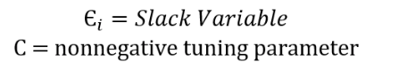
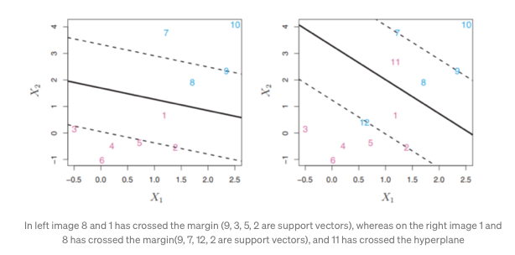
The support vector classifier contains a tuning parameter in order to control how much misclassification it will allow.
This tuning parameter is important when looking to minimize error. As with all supervised learning, there is a bias-variance tradeoff.
If the slack variable is equal to zero then it means that “i th” observation is on correct side of margin and if slack variable is > than 0 then it means “i th” observation is on wrong side of margin. If slack variable is greater than 1 then “i th” observation is on the wrong side of the hyperplane.
The variable C is the penalty strength, which specifies how much do we care about errors (training points that are on the wrong side).

Slide 37
Support Vector Classifier
4
7
10
4
7
10
3
3
11
9
9
X2
2
8
X2
2
8
1
1
1
1
3
3
12
0
5
0
5
4
2
4
2
−1
6
−1
6
−0.5 0.0
0.5 1.0 1.5
2.0
2.5
−0.5 0.0 0.5 1.0 1.5 2.0 2.5
X1
X1

Slide 38
C is a regularization parameter
3
−3 −2 −1 0 1 2 3 −3 −2 −1 0 1 2 3
2
1
^{X}2
0
^{X}2
−1
−2
−3
−1
0
1
2
−1
0
1
2
^{X}1
^{X}1
3
2
1
^{X}2
−3 −2 −1 0
^{X}2
−1
0
1
2
−1
0
1
2
^{X}1
^{X}1

Slide 39
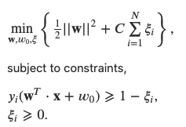
Soft Margin Classification
If the training set is not linearly separable, Slack variables ξ_{i} can be added to allow misclassification of difficult or noisy examples, resulting margin called soft.
We can now consider a combined effect. We would like to maximize the margin and allow for total error of some magnitude. Optimization problem takes the form
What should our quadratic optimization criterion be?
Minimize
ξ_{i}
ξ_{i}

Slide 40
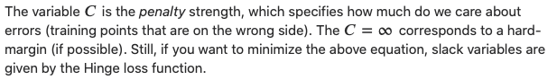
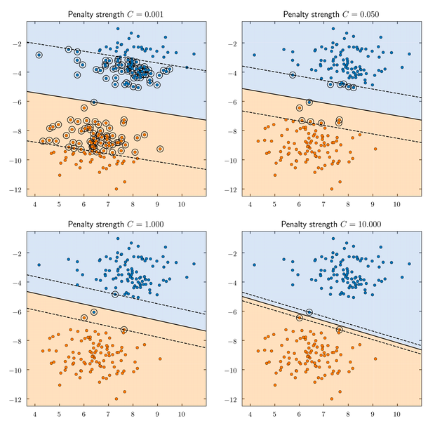
In a sense, C acts as a control that adjusts the balance between margin maximization and error minimization. Choosing an appropriate value for C is important based on the problem and dataset at hand. A smaller C might be preferred when there is significant noise or outliers in the data, whereas a larger C might be suitable for cleaner datasets where misclassifications are less acceptable.

Slide 41
The old formulation:
The new formulation incorporating slack variables:
Parameter C can be viewed as a way to control overfitting.
Find w and b such that
Φ(w) =½ w^{T}w is minimized and for all {(x_{i} ,y_{i})}
y_{i} (w^{T}x_{i} + b) ≥ 1
Find w and b such that
Φ(w) =½ w^{T}w + CΣξ_{i} is minimized and for all {(x_{i} ,y_{i})}
y_{i} (w^{T}x_{i} + b) ≥ 1- ξ_{i} and ξ_{i} ≥ 0 for all i

Slide 42
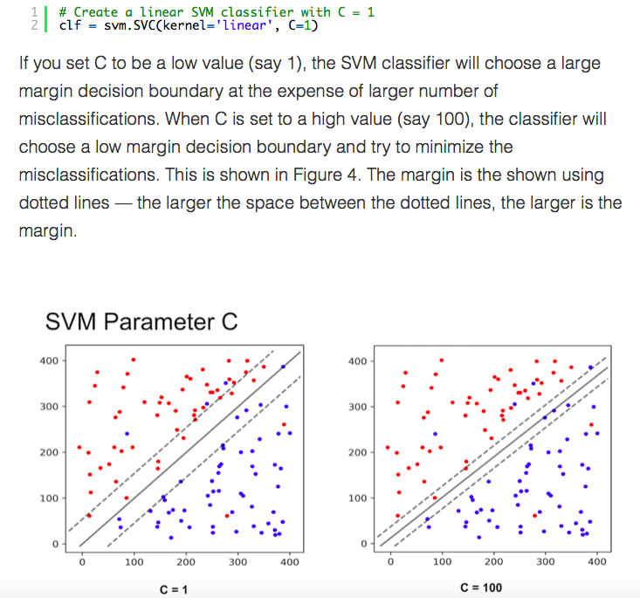
Noisy data
You may be tempted to ask which value of C is better. The answer depends on how much noise you think there is in your data. If you think the data is very noisy, you want C to be small. On the other hand, if you think the data is less noisy, you should choose C to be large.

Slide 43
SVM Support Vector Machine
SVM offers very high accuracy compared to other classifiers
It is used in a variety of applications such as face detection, intrusion detection, classification of emails, news articles and web pages, classification of genes, and handwriting recognition
The classifier separates data points using a hyperplane with the largest amount of margin. That's why an SVM classifier is also known as a discriminative classifier. SVM finds an optimal hyperplane that helps classify new data points.

Slide 44
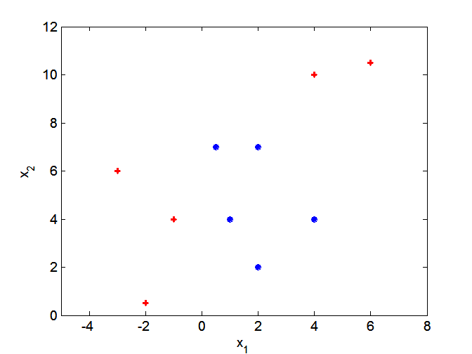
Support vector machines
What if decision boundary is not linear?

Slide 45
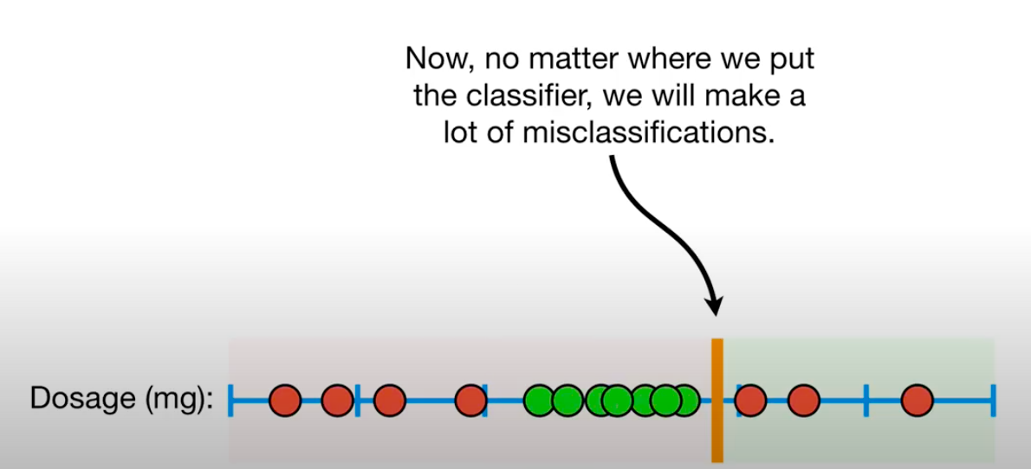

Slide 46
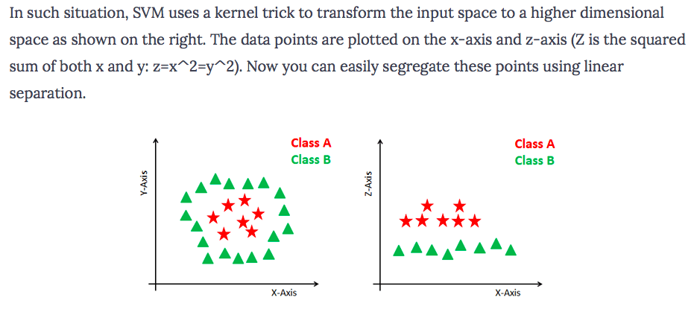
Dealing with non-linear and inseparable planes
Some problems can’t be solved using linear hyperplane:

Slide 47
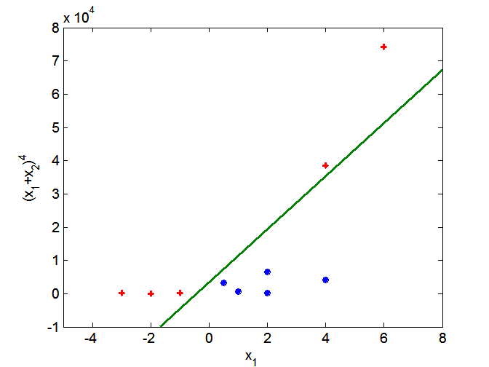
Support vector machines
Solution: nonlinear transform of attributes
One approach to
handling nonlinear datasets is to add more features, such as polynomial features

Slide 48
Support vector machines
Solution: nonlinear transform of attributes

Slide 49
Non-linear SVMs: Feature spaces
General idea: the original feature space can always be mapped to some higher-dimensional feature space where the training set is separable:
Φ: x → φ(x)

Slide 50
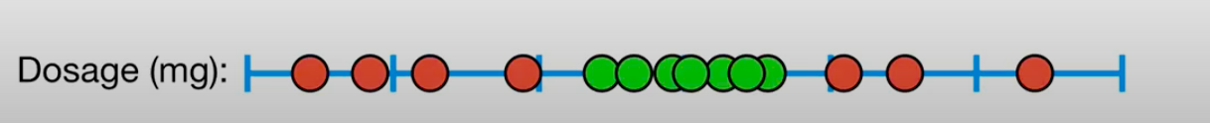
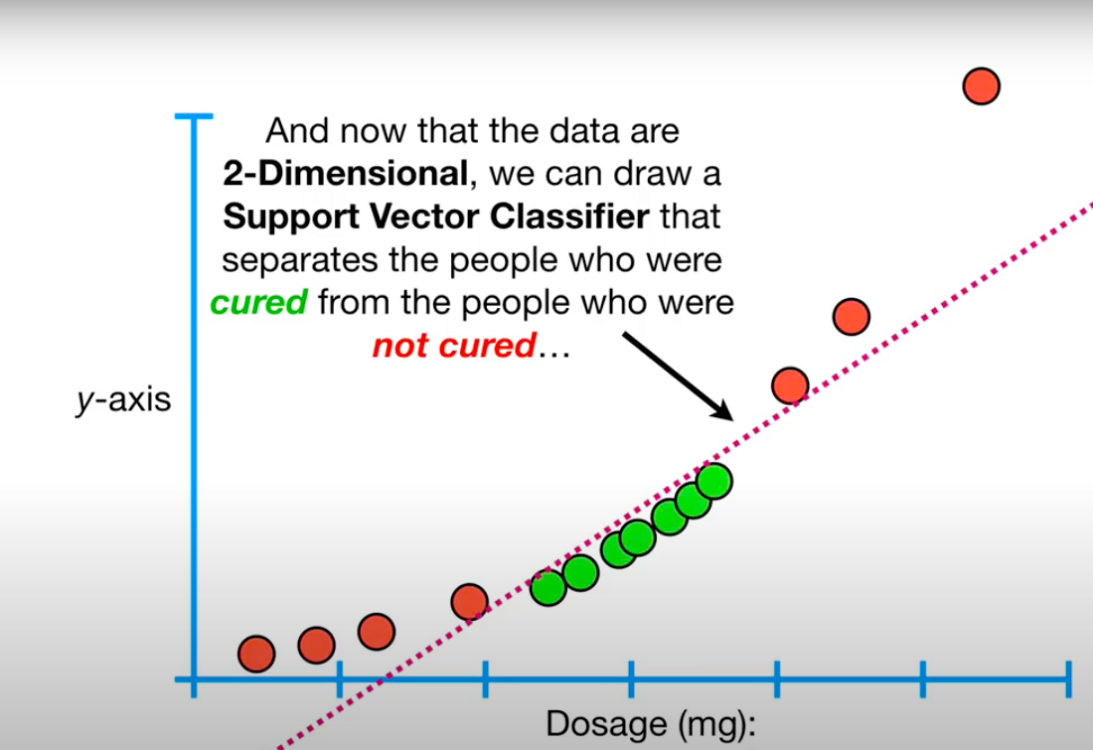
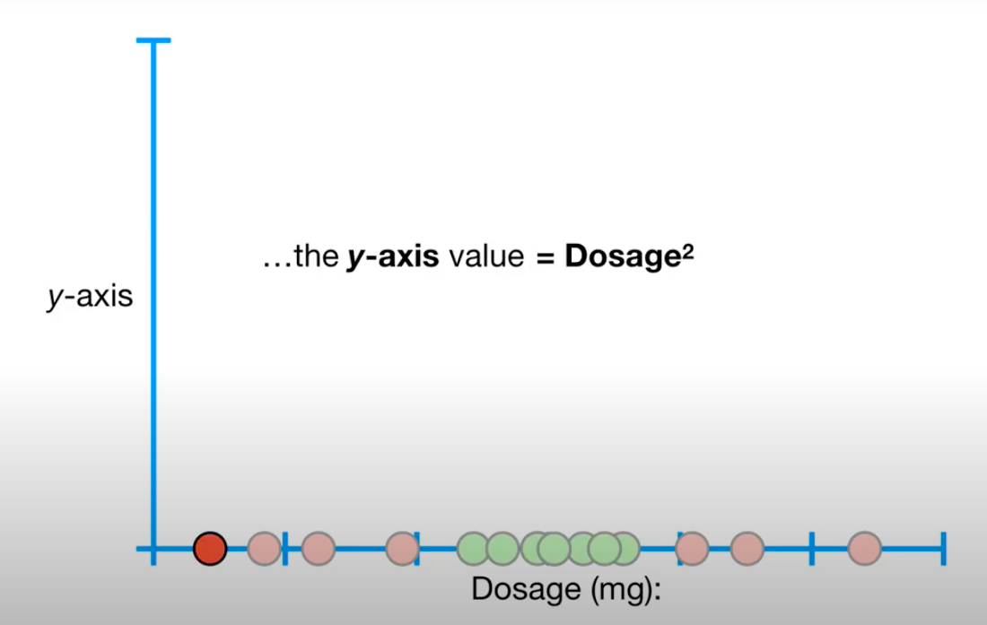

Slide 51
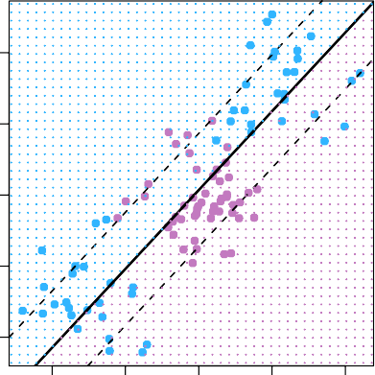
Linear boundary can fail
4
Sometime a linear bound- ary simply won’t work, no matter what value of C.
The example on the left is such a case.
What to do?
2
X₂
0
−2
−4
−4
−2
0
2
4
X₁

Slide 52
Feature Expansion
Enlarge the space of features by including transformations;
e.g. X², X³, X₁X₂, X₁X²,. . .. Hence go from a
1 1 2
p-dimensional space to a M > p dimensional space.
Fit a support-vector classifier in the enlarged space.
This results in non-linear decision boundaries in the original space.
Example: Suppose we use (X₁, X₂, X², X², X₁X₂) instead of
1 2
just (X₁, X₂). Then the decision boundary would be of the form
β₀ + β₁X₁ + β₂X₂ + β₃X² + β₄X² + β₅X₁X₂ = 0
1 2
This leads to nonlinear decision boundaries in the original space (quadratic conic sections).

Slide 53
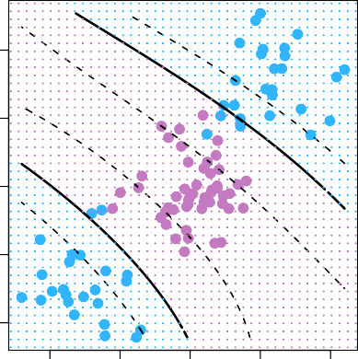
Cubic Polynomials
Here we use a basis expansion of cubic poly- nomials
From 2 variables to 9
The support-vector clas- sifier in the enlarged space solves the problem in the lower-dimensional space
4
2
X₂
0
−2
−4
−4
−2
0
2
4
X₁
β0 +β1X1 +β2X2 +β3X² +β4X² +β5X1X2 +β6X³ +β7X³ +β8X1X² +β9X²X2 = 0
1 2 1 2 2 1

Slide 54
SVM Kernels
The SVM algorithm is implemented in practice using a kernel.
A kernel transforms an input data space into the required form.
SVM uses a technique called the kernel trick. Here, the kernel takes a low-dimensional input space and transforms it into a higher dimensional space.
Kernel trick helps you to build a more accurate classifier.
Kernel: The main function of the kernel is to transform the given dataset input data into the required form. There are various types of functions such as linear, polynomial, and radial basis function (RBF). Polynomial and RBF are useful for non-linear hyperplane.
Polynomial and RBF kernels compute the separation line in the higher dimension. In some of the applications, it is suggested to use a more complex kernel to separate the classes that are curved or nonlinear. This transformation can lead to more accurate classifiers.

Slide 55
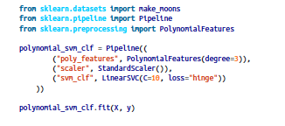
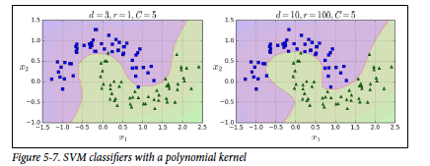
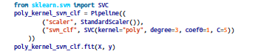
Polynomial Kernel

Slide 56
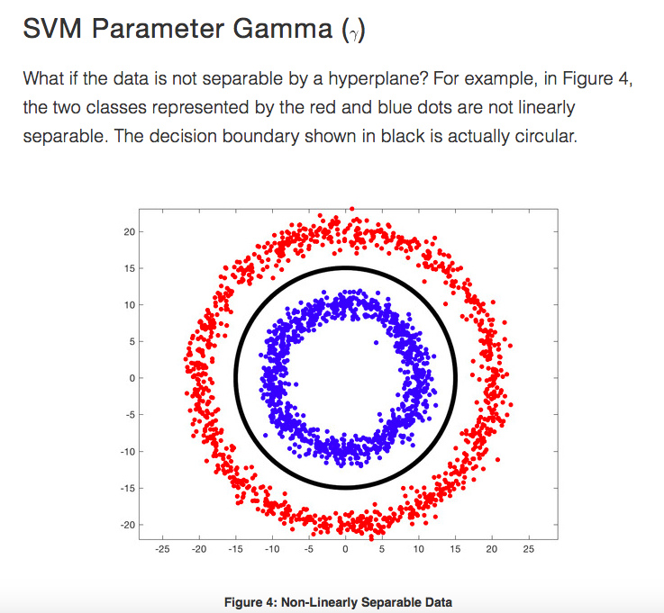
Gaussian RBF Kernel
In such a case, we use the Kernel Trick where we add a new dimension to existing data and if we are lucky, in the new space, the data is linearly separable.
Lets add a third dimension (z) to the data where,
The above expression is called a Gaussian Radial Basis Function or a Radial Basis Function with a Gaussian kernel.

Slide 57
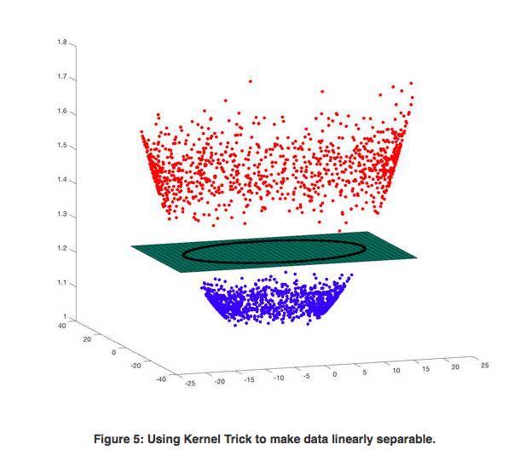

Slide 58
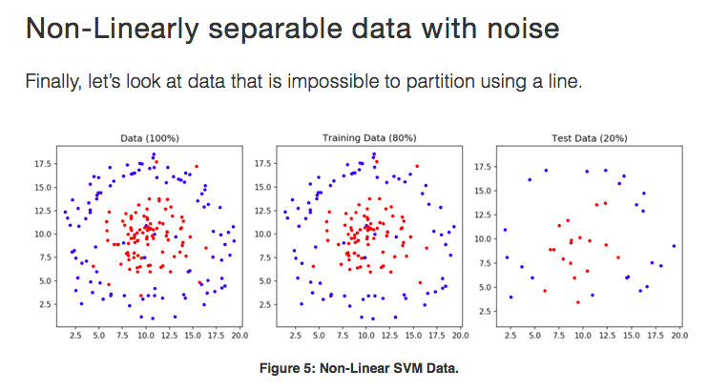

Slide 59
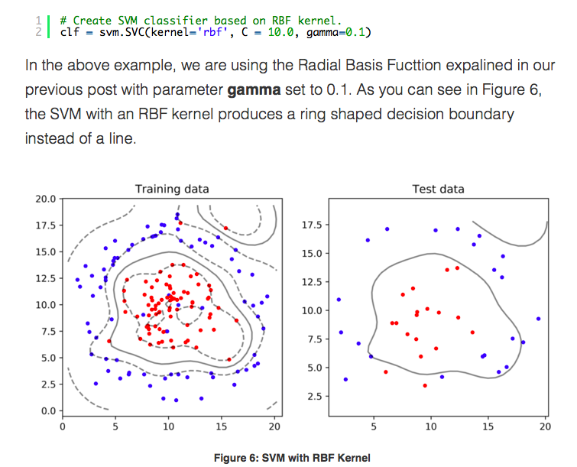

Slide 60
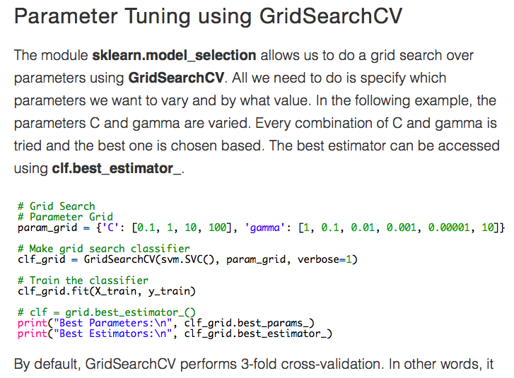

Slide 61
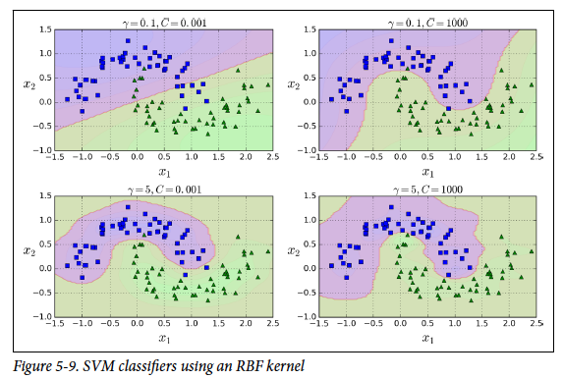

Slide 62
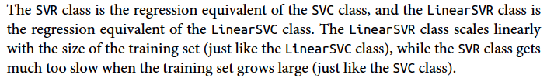
Regression
The SVM algorithm is versatile: not only does it support linear and nonlinear classification, but it also supports linear and nonlinear regression. To use SVMs for regression instead of classification, the trick is to reverse the objective: instead of trying to fit the largest possible street between two classes while limiting margin violations, SVM Regression tries to fit as many instances as possible on the street while limiting margin violations (i.e., instances off the street).

Slide 63
Advantages
SVM Classifiers offer good accuracy and perform faster prediction compared to Naïve Bayes algorithm. They also use less memory because they use a subset of training points in the decision phase. SVM works well with a clear margin of separation and with high dimensional space.
Disadvantages
SVM is not suitable for large datasets because of its high training time and it also takes more time in training compared to Naïve Bayes. It works poorly with overlapping classes and is also sensitive to the type of kernel used.

Slide 64
SVM applications
SVMs were originally proposed by Boser, Guyon and Vapnik in 1992 and gained increasing popularity in late 1990s.
SVMs are currently among the best performers for a number of classification tasks ranging from text to genomic data.
SVMs can be applied to complex data types beyond feature vectors (e.g. graphs, sequences, relational data) by designing kernel functions for such data.
SVM techniques have been extended to a number of tasks such as regression [Vapnik et al. ’97], principal component analysis [Schölkopf et al. ’99], etc.
Tuning SVMs remains a black art: selecting a specific kernel and parameters is usually done in a try-and-see manner.
More mathematical material you can find in the text book!
Demo ☺
http://vision.stanford.edu/teaching/cs231n-demos/linear-classify/
https://cs.stanford.edu/people/karpathy/svmjs/demo/

Slide 65
Nonlinearities and Kernels
Polynomials (especially high-dimensional ones) get wild rather fast.
There is a more elegant and controlled way to introduce nonlinearities in support-vector classifiers — through the use of kernels.
Before we discuss these, we must understand the role of
inner products in support-vector classifiers.

Slide 66
Inner products and support vectors
p
Σ
⟨x , x ′ ⟩ = x x ′
— inner product between vectors
i i ij i j
j=1
The linear support vector classifier can be represented as
n
Σ
f (x) = β + α ⟨x, x ⟩ — n parameters
0 i i
i=1
To estimate the parameters α₁, . . . , α_{n} and β₀, all we need
n
are the inner products ⟨x , x
′ ⟩ between all pairs of
2
i i
training observations.
It turns out that most of the αˆ_{i} can be zero:
f (x) = β₀ + ^{Σ} αˆ_{i}⟨x, x_{i}⟩
i∈S
S is the support set of indices i such that αˆ_{i} > 0. [see slide 8]

Slide 67
Kernels and Support Vector Machines
If we can compute inner-products between observations, we can fit a SV classifier. Can be quite abstract!
Some special kernel functions can do this for us. E.g.
,
K(x_{i}, x_{i}′ ) = 1 +
_{d}
^{x}ij^{x}i′j 
p
Σ
j=1
computes the inner-products needed for d dimensional
polynomials —
p+d
basis functions!
d
Try it for p = 2 and d = 2.
The solution has the form
f (x) = β₀ + ^{Σ} αˆ_{i}K(x, x_{i}).
i∈S

Slide 68
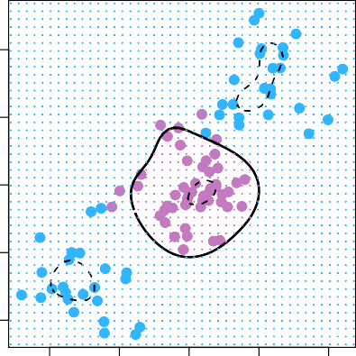
Radial Kernel
p
Σ
2
K(x , x ′ ) = exp(−γ (x − x ′ ) ).
i i ij i j
j=1
4
f (x) = β₀+^{Σ} αˆ_{i}K(x, x_{i})
i∈S
Implicit feature space; very high dimensional.
Controls variance by squashing down most dimensions severely
2
X₂
0
−2
−4
−4
−2
0
2
4
X₁
16 / 21

Slide 69
Example: Heart Data
1.0
1.0
0.8
0.8
True positive rate
True positive rate
0.6
0.6
0.4
0.4
0.2
0.2
Support Vector Classifier SVM: γ=10⁻³
SVM: γ=10⁻²
SVM: γ=10⁻¹
0.4 0.6 0.8 1.0
False positive rate
Support Vector Classifier LDA
0.4 0.6 0.8 1.0
False positive rate
0.0
0.0
0.0
0.2
0.0
0.2
ROC curve is obtained by changing the threshold 0 to threshold t in f^{ˆ}(X) > t, and recording false positive and true positive rates as t varies. Here we see ROC curves on training data.

Slide 70
Example continued: Heart Test Data
1.0
1.0
0.8
0.8
True positive rate
True positive rate
0.6
0.6
0.4
0.4
0.2
0.2
Support Vector Classifier SVM: γ=10⁻³
SVM: γ=10⁻²
SVM: γ=10⁻¹
0.4 0.6 0.8 1.0
False positive rate
Support Vector Classifier LDA
0.4 0.6 0.8 1.0
False positive rate
0.0
0.0
0.0
0.2
0.0
0.2

Slide 71
SVMs: more than 2 classes?
The SVM as defined works for K = 2 classes. What do we do if we have K > 2 classes?
OVA One versus All. Fit K different 2-class SVM classifiers f^{ˆ}_{k}(x), k = 1, . . . , K; each class versus the rest. Classify x∗ to the class for which f^{ˆ}_{k}(x∗) is largest.
K
OVO One versus One. Fit all pairwise classifiers
2
f^{ˆ}_{kl}(x). Classify x∗ to the class that wins the most pairwise competitions.
Which to choose? If K is not too large, use OVO.

Slide 72
Support Vector versus Logistic Regression?
With f (X) = β₀ + β₁X₁ + . . . + β_{p}X_{p} can rephrase support-vector classifier optimization as
,_{Σn}
,
,
p
Σ
j=1
minimize max [0, 1 − y_{i}f (x_{i})] + λ
β0,β1,...,βp ,_{i=1}
_{β}2
j
8
SVM Loss
Logistic Regression Loss
This has the form
loss plus penalty.
The loss is known as the
hinge loss.
Very similar to “loss” in logistic regression (negative log-likelihood).
6
Loss
4
2
0
−6
−4 −2 0 2
yi(β0 + β1xi1 + . . . + βpxip)

Slide 73
Which to use: SVM or Logistic Regression
When classes are (nearly) separable, SVM does better than LR. So does LDA.
When not, LR (with ridge penalty) and SVM very similar.
If you wish to estimate probabilities, LR is the choice.
For nonlinear boundaries, kernel SVMs are popular. Can use kernels with LR and LDA as well, but computations are more expensive.

